Slide 1
TOPIC- SENTENCE SIMILARITY
TEAM MEMBERS- (Team ID 13)
1. Soumyaraj Roy , 19BCE0200
2. Kaustubh Dwivedi, 19BCE0249
3. Rebello Nishma Avalon, 19BCE0253
4. Debangsu Sarkar, 19BCE0902

Slide 2
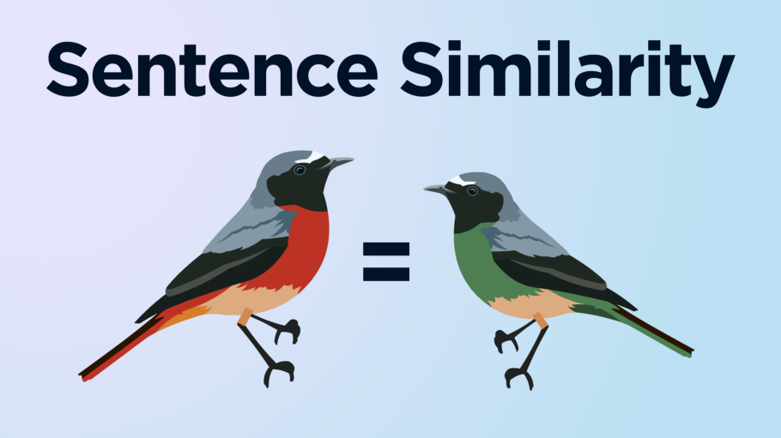
INTRODUCTION :
Sentence similarity is a measure of how similar two pieces of text are, or to what degree they express the same meaning.
Related tasks include paraphrase or duplicate identification, search, and matching applications. The common methods used for text similarity range from simple word-vector dot products to pairwise classification, and more recently, deep neural networks.
Estimating Semantic Textual Similarity, between words or terms, sentences, section and record assumes a significant part in software engineering and computational language learning. It additionally has numerous applications more than a few fields like Biomedical Informatics and Geoinformation.

Slide 3
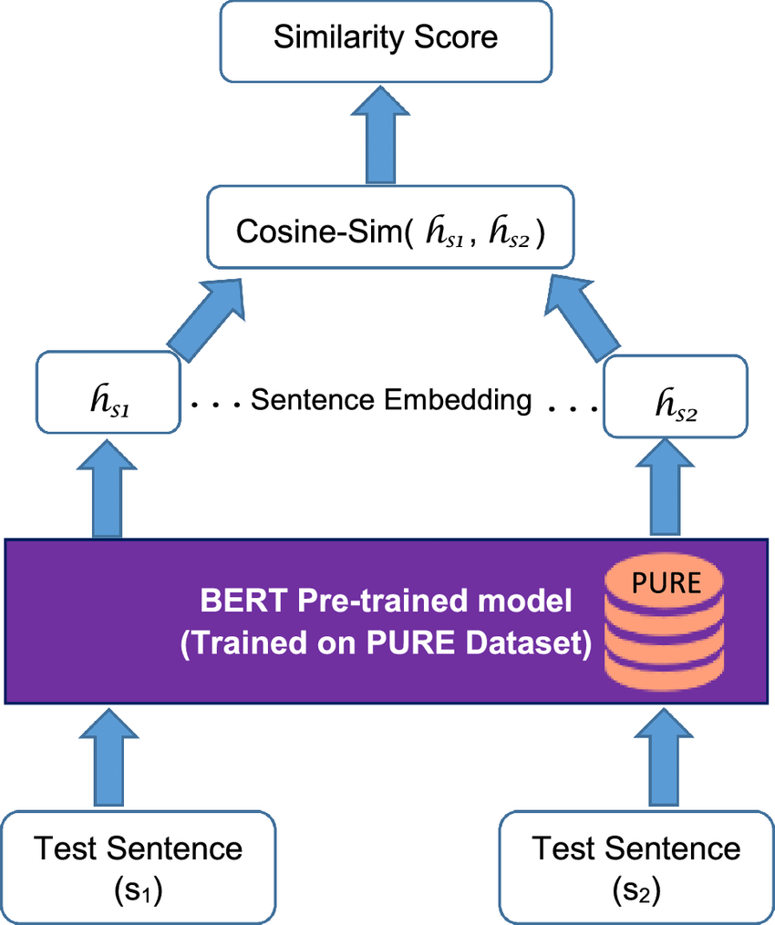
PROCESS :
Sentence similarity is normally calculated by the following steps:
1. Take a sentence, convert it into a vector.
2. Take many other sentences and convert them into vectors.
3. Find sentences that have the smallest Euclidean distance or smallest angle i.e.,
cosine similarity, between them.
3. We now have a measure of semantic similarity between sentences.
For this process we can use BERT i.e., Bidirectional Encoder Representations from Transformers. It is a transformer-based machine learning technique for natural language processing pre-training developed by Google.
BERT makes use of Transformer, an attention mechanism that learns contextual relations between words (or sub-words) in a text.
BERT has the ability to embed the meaning of words into densely packed vectors.
BERT is great at creating dense vectors, and each encoder layer (there are several) outputs a set of dense vectors.

Slide 4
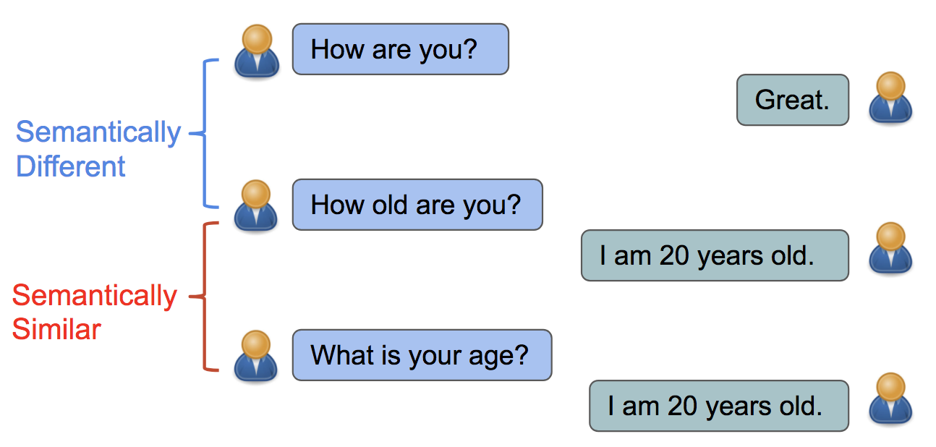
For BERT base, this will be a vector containing 768. Those 768 values contain our numerical representation of a single token — which we can use as contextual word embeddings.
Because there is one of these vectors for representing each token (output by each encoder), we are actually looking at a tensor of size 768 by the number of tokens.
We can take these tensors — and transform them to create semantic representations of the input sequence. We can then take our similarity metrics and calculate the respective similarity between different sequences.
The simplest and most commonly extracted tensor is the last_hidden_state tensor , which is conveniently output by the BERT model.
For us to convert our last_hidden_states tensor into our vector, we use a mean pooling operation.
Each of those 512 tokens has a respective 768 values. This pooling operation will take the mean of all token embeddings and compress them into a single 768 vector space — creating a ‘sentence vector’.

Slide 5
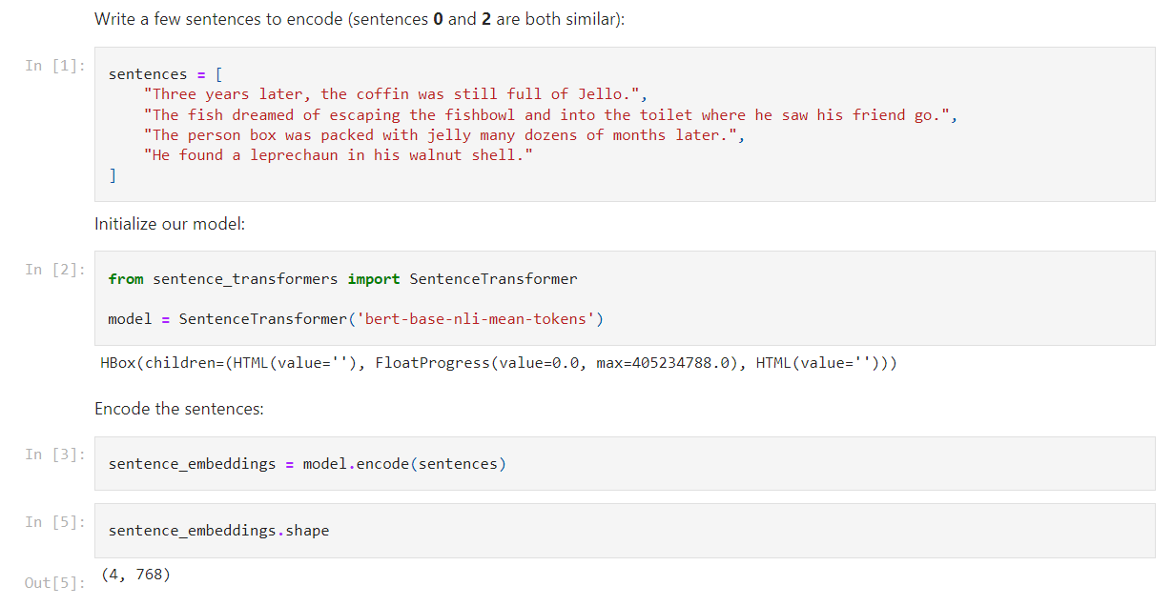
Use Sentence-transformers library, which is a Python framework for state-of-the-art sentence, text and image embeddings.
First, we install sentence-transformers using pip install sentence-transformers. This library uses Hugging Face’s transformers behind the scenes, so we can find sentence-transformers models here.
We will use the bert-base-nli-mean-tokens model.
Let’s create some sentences, initialize our model, and encode the sentences:

Slide 6
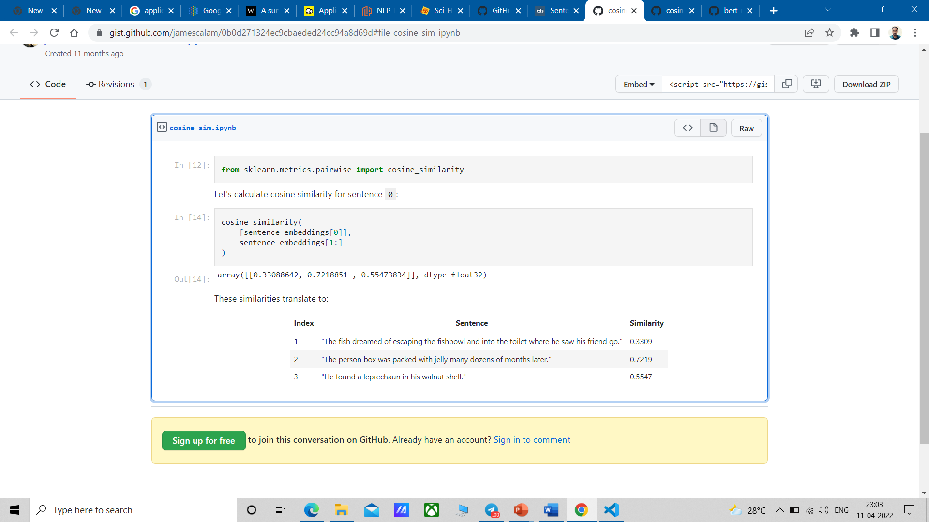
Great, we now have four sentence embeddings — each containing 768 values.
Now what we do is take those embeddings and find the cosine similarity between each.
So, for sentence 0:
Three years later, the coffin was still full of Jello.
We can find the most similar sentence using:

Slide 7

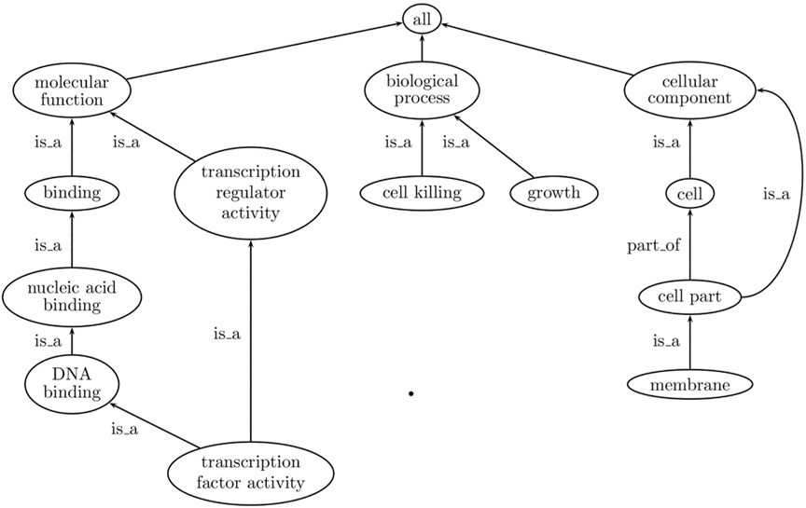
APPLICATIONS :
1. Question-and-answer sites such as Quora need to determine whether a question has already been asked before.
This type of text similarity is often computed by first embedding the two short texts and then calculating the cosine similarity between them.
2. Biomedicine: Section of the GO graph showing the three aspects (molecular function, biological process, and cellular component) and some of their descendant terms.
The fact that GO is a DAG rather than a tree is illustrated by the term “transcription factor activity” which has two parents.
An example of a part of relationship is also shown between the terms cell part and cell.

Slide 8
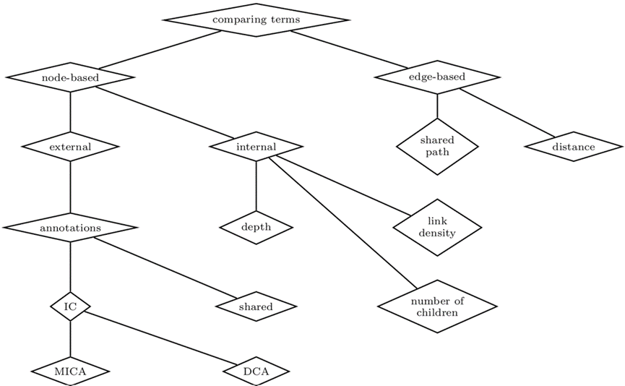
Section of the GO graph showing the three aspects (molecular function, biological process, and cellular component) and some of their descendant terms.
The fact that GO is a DAG rather than a tree is illustrated by the term “transcription factor activity” which has two parents. An example of a part of relationship is also shown between the terms cell part and cell.
For instance, GO-based semantic similarity can be used to compare gene products by their biochemical function i.e., molecular function, the cellular and supracellular processes in which they are involved (biological process), and their cellular or extracellular location (cellular component).
Comparing the molecular function aspect, we can measure the functional similarity between gene products and gain insight into function-related characteristics such as domains and active sites

Slide 9
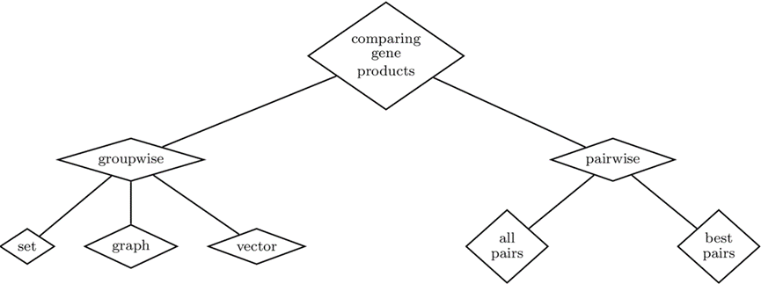
Main approaches for comparing gene products: pairwise and groupwise and the techniques used by each approach.
Semantic similarity can also play an important role in both predicting and validating gene product interactions and interaction networks. Regarding prediction, some authors developed methods based solely on semantic similarity, whereas others combined semantic similarity with gene expression data.
As for validation of interactions, semantic similarity has been used to select a negative dataset of non interacting proteins to assess prediction methods, to improve the performance of predictions by excluding false positives, and to assess the quality of predicted interaction networks by comparing them to experimentally verified interactions.

Slide 10

2. Geo-Informatics: Similarity measure also used to find the similarities between geographical feature type ontologies.
Several tools are available to do this task such as-
The OSM Semantic Network used to compute the semantic similarity of tags in OpenStreetMap 7.
(ii) Similarity Calculator is used to find the similarity between two geographical concepts in the Geo-Net-PT ontology.
(iii) SIM-DL similarity server computes the similarity between geographical feature type ontologies.
3. Social networks: As a basic method of text related research and application, semantic similarity measures are often used in social network analysis.
Micro-blogging services such as Twitter constitute one of the most successful kinds of applications in the current social networks. It can be used to discover similar topics and find interesting tweets for users.
An algorithm called TS-LDA is proposed, which extracts topics from the content by modeling the time trend on twitter.

Slide 11
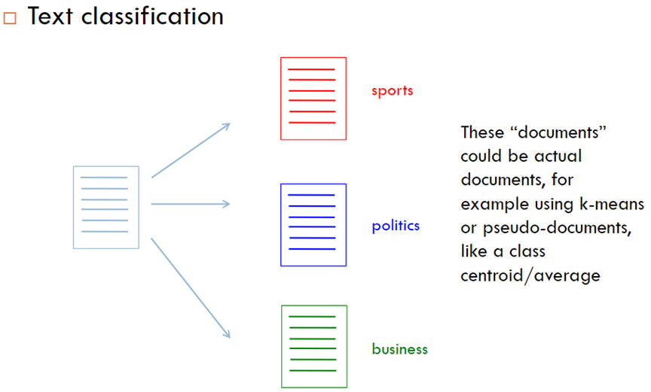
4. Academic plagiarism detection:
Academic plagiarism is one of the most serious academic phenomena nowadays, which has seriously affected the goals we are pursuing. It is urgent to develop a qualified plagiarism detection tool.
Now, there are many plagiarism detections tools and software that have been successfully used, but the plagiarism phenomenon remains unresolved because the types of plagiarism are diverse. To apply text semantic similarity to the plagiarism detection task one can, classify existing semantic similarity measures and analyze their possible usage for paraphrasing detection.
In addition, the use of semantic similarity in multilingual detection has also made good progress
5. Text classification and text clustering:
Text classification as a task of identifying the text content and match according to the defined categories.
Clustering is a technique that compares the similarity of a group of document or text information and classifies the similar document or text information into the same group.

Slide 12
EXAMPLE :
Sentence Similarity Calculator-
This application contains various ways to calculate the similarity between source and target sentences. You can choose the pre-trained models you want to use such as ELMo, BERT and Universal Sentence Encoder (USE).
And we can also choose the method to be used to get the similarity:
1. Cosine similarity
2. Manhattan distance
3. Euclidean distance
4. Angular distance
5. Inner product
6. TS-SS score
7. Pairwise-cosine similarity
8. Pairwise-cosine similarity + IDF
We can experiment with (The number of models) x (The number of methods) combinations.

Slide 13
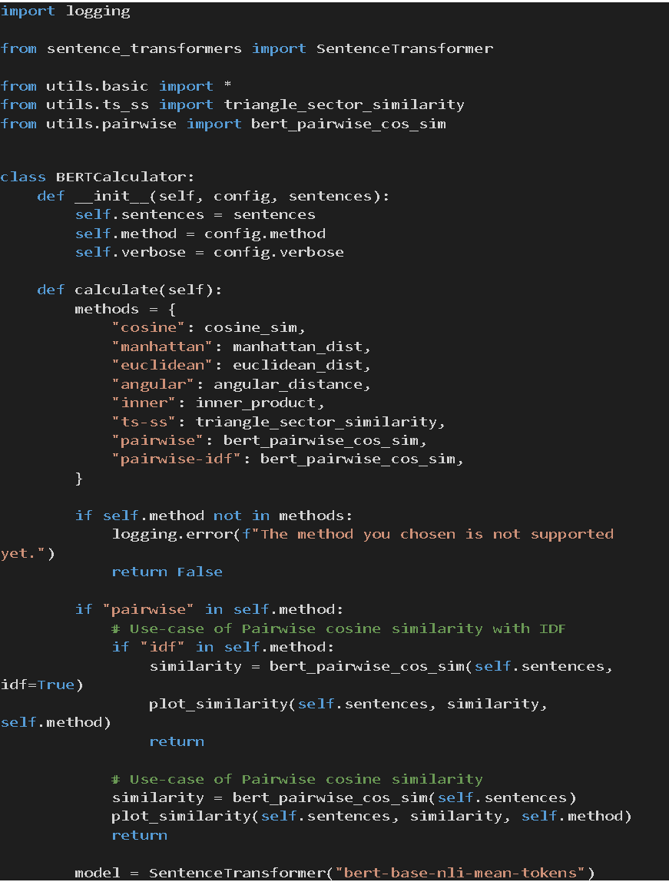
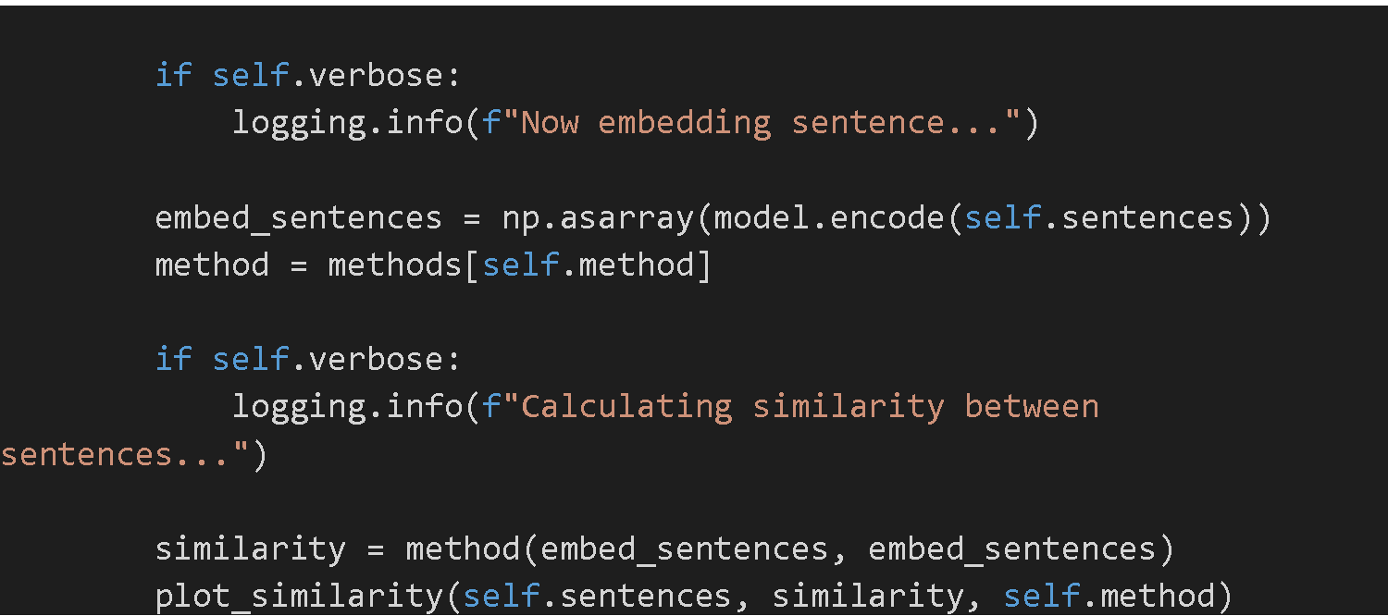
BERT Model:

Slide 14
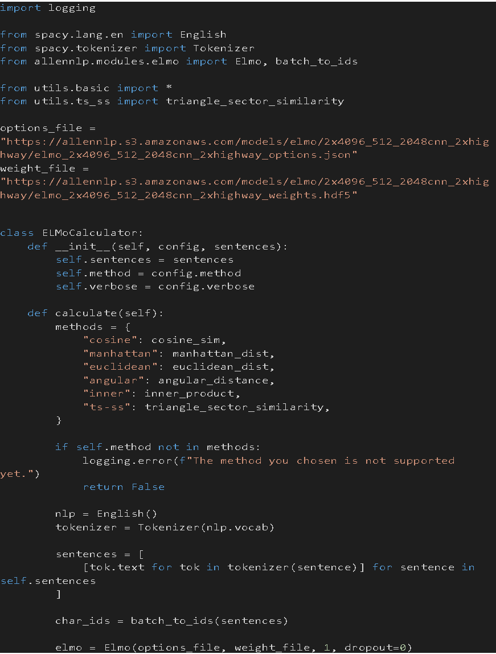
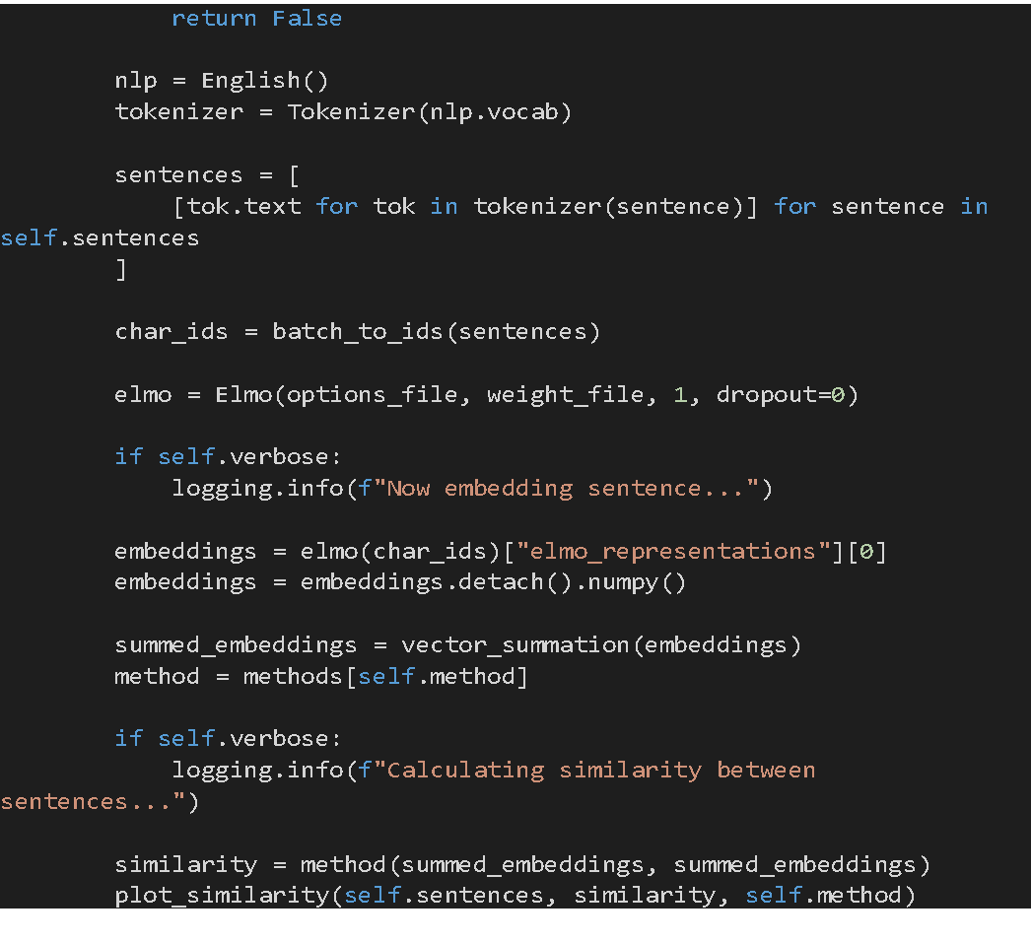
ELmo Model:

Slide 15
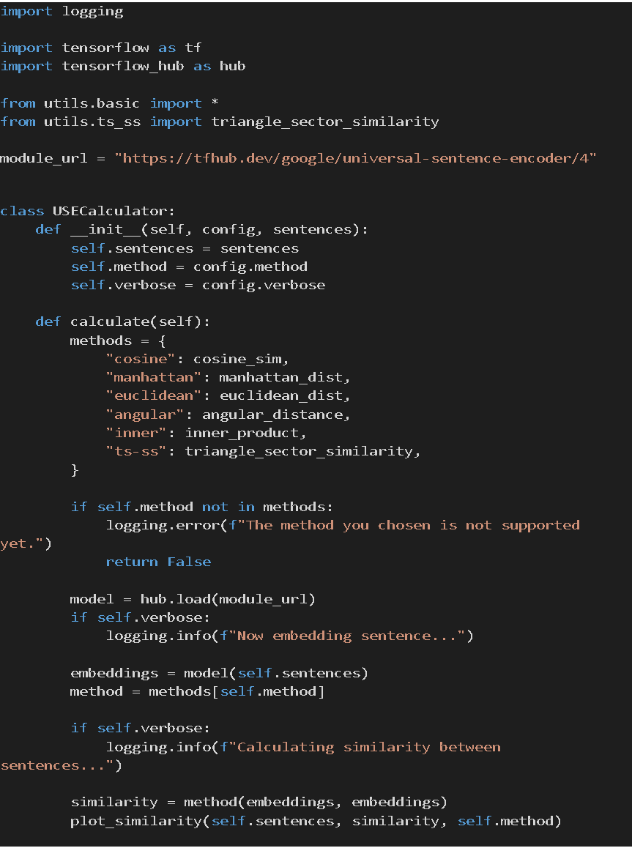
Universal Sentence Encoder (USE) model:

Slide 16
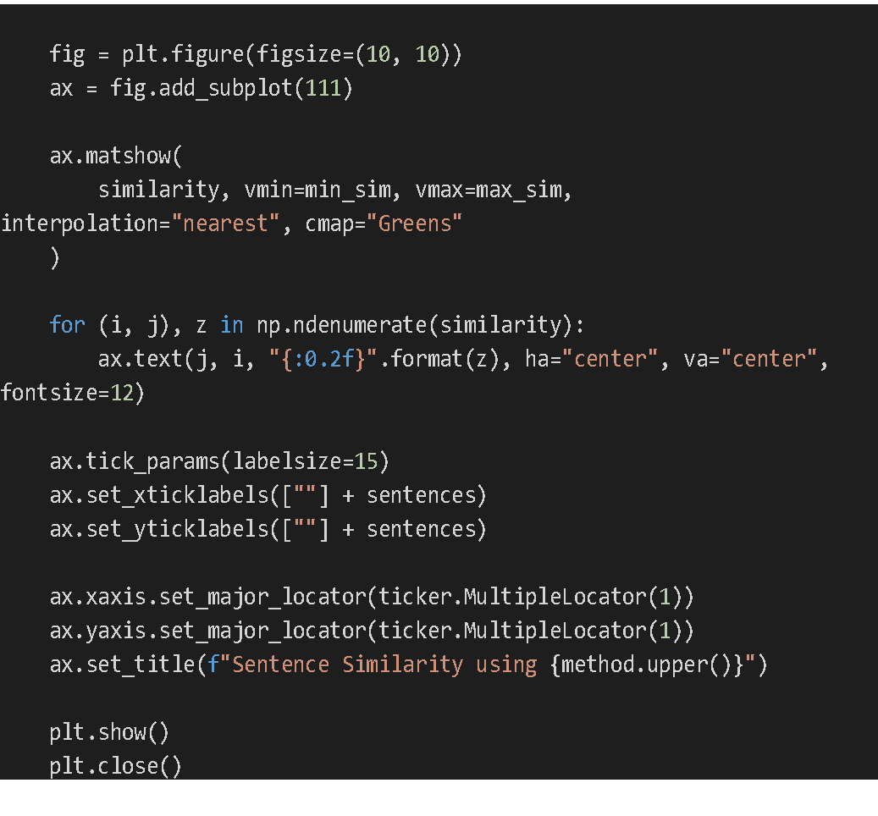
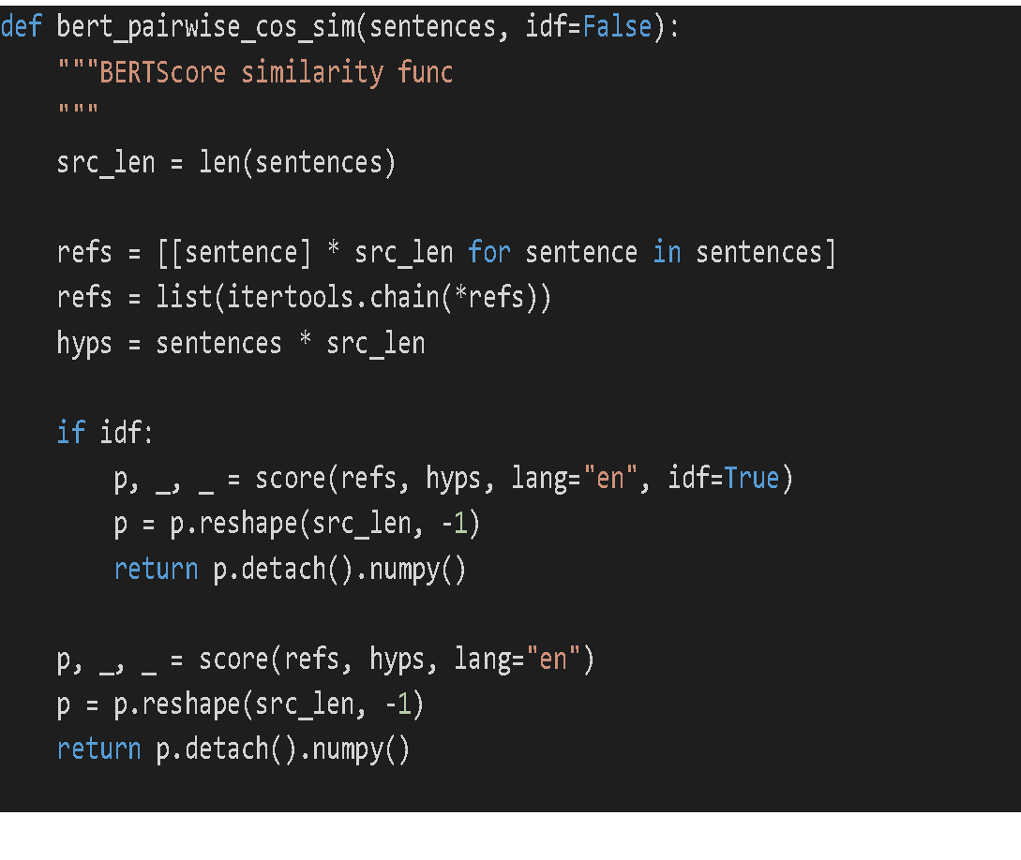
basic.py
BERT score similarity function:

Slide 17
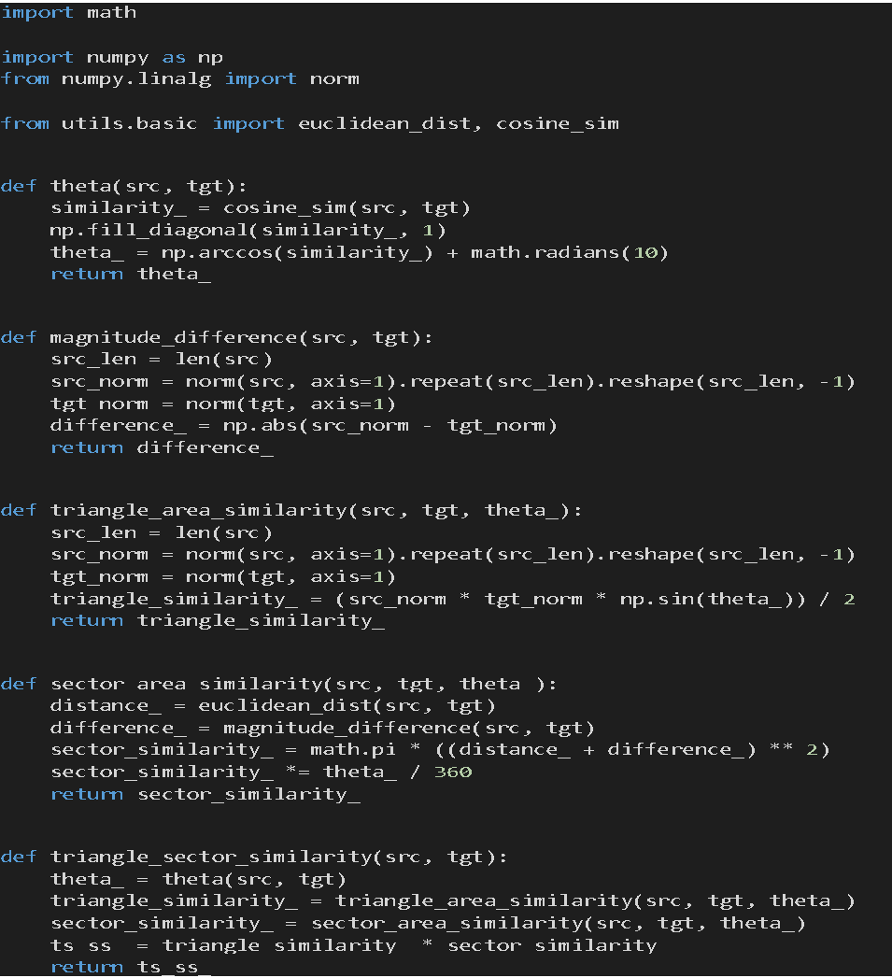
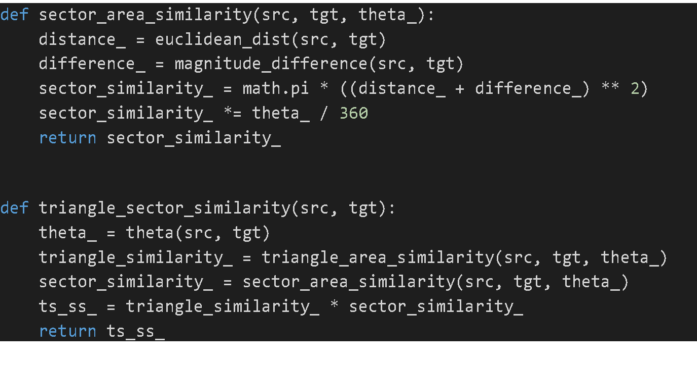
Calculating theta, magnitude difference, triangle area similarity and sector area similarity

Slide 18
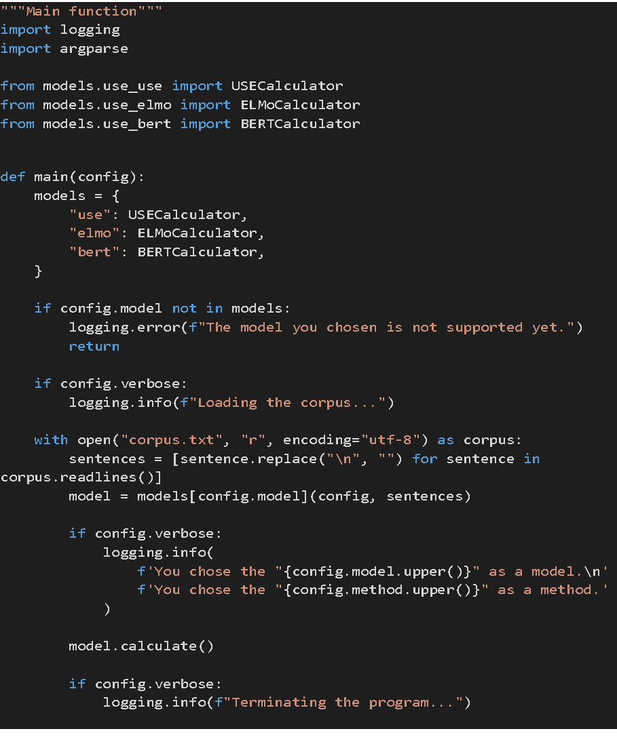
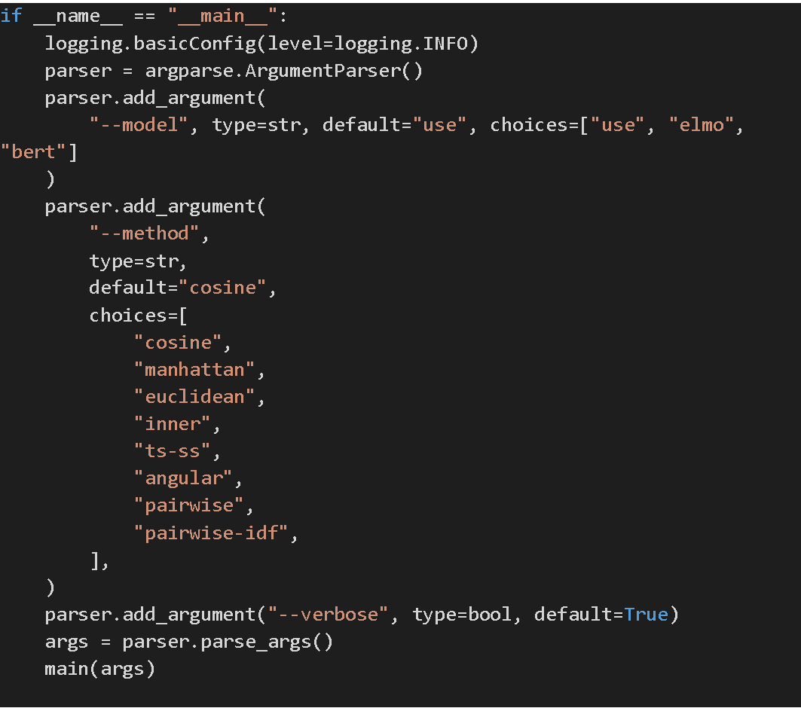
Main function of the sentence similarity calculator:

Slide 19
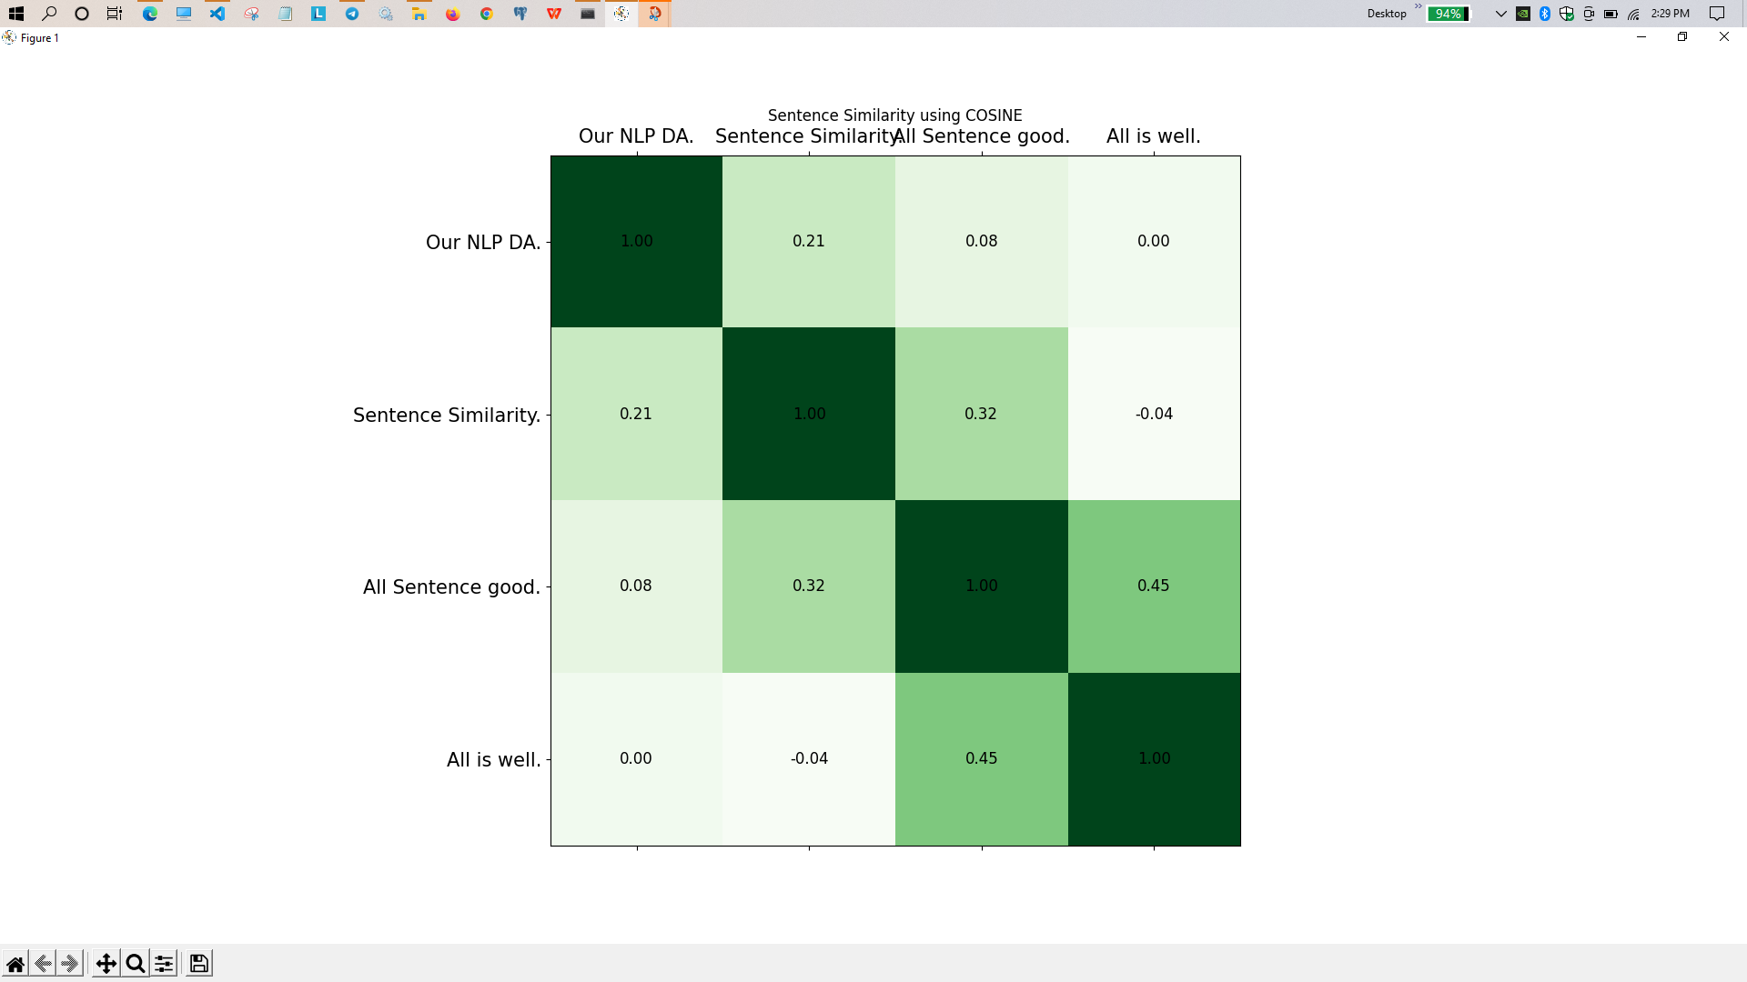
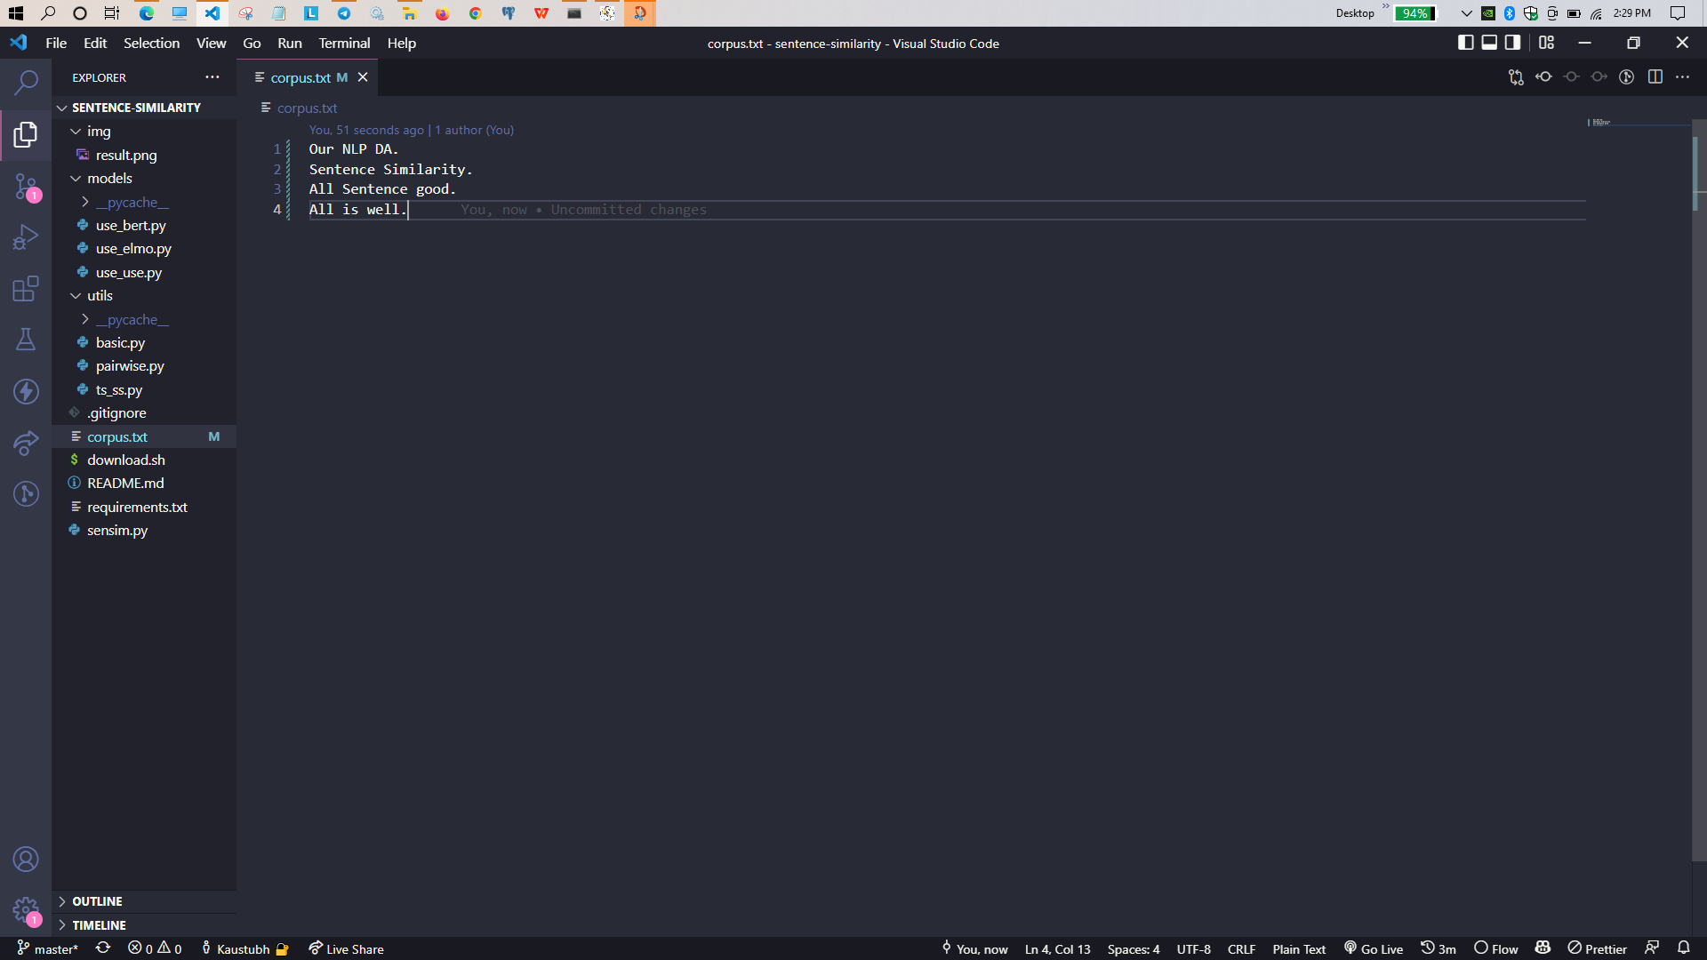
Input Sentence
Output
Here, we can see the example result of sentence-similarity.

Slide 20
Conclusion
Many NLP applications need to compute the similarity in meaning between two sentences or texts. Search engines, for example, need to model the relevance of a document to a query, beyond the overlap in words between the two. Thus, in this assignment we provided the process of computing sentence similarity and presented an application to calculate the same.

Slide 21
Thankyou

